Slide 1
Part 2 What is HDF?
(Focus on HDF5)

Slide 2
Why HDF5?
In one sentence ...

Slide 3
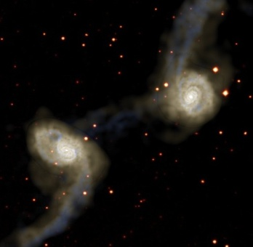
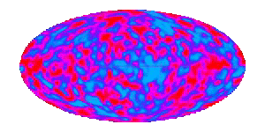


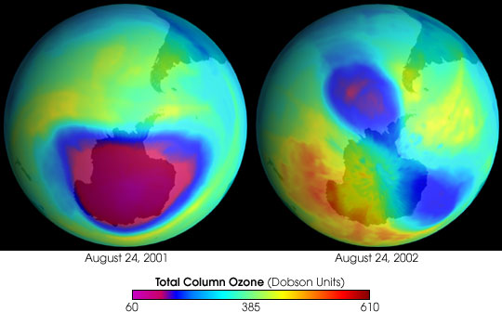
Answering big questions …
Matter and the universe
Life and nature
August 24, 2001
August 24, 2002
Total Column Ozone (Dobson)
60 385 610
Weather and climate
3

Slide 4
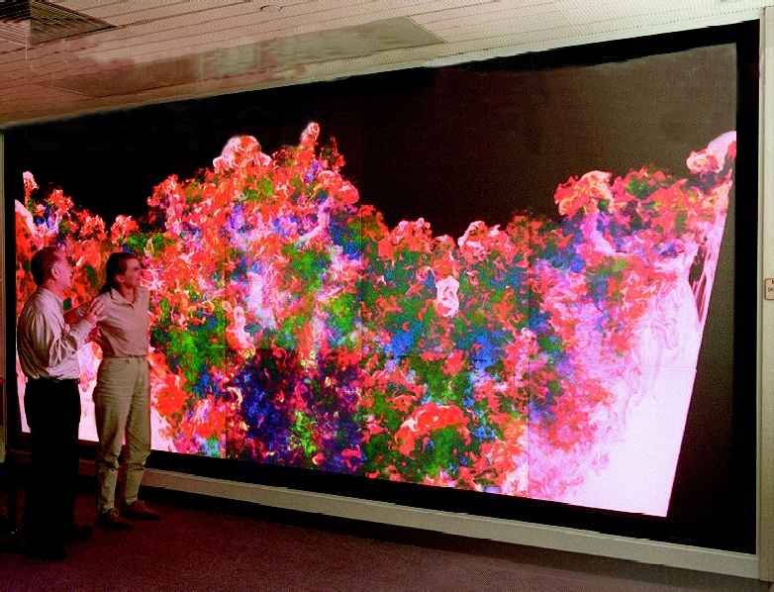
… involves big data …
4

Slide 5
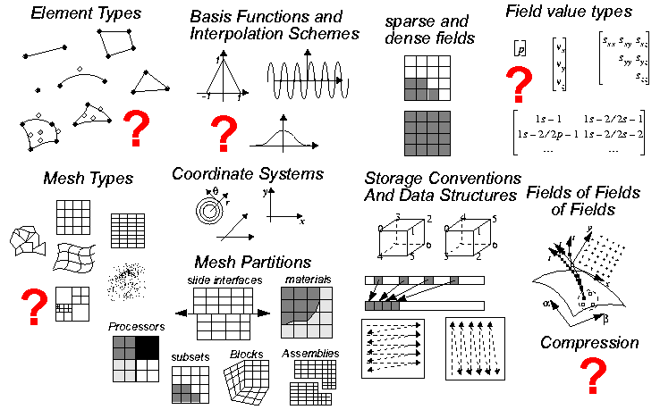
… and complex data …
LCI Tutorial
Thanks to Mark Miller, LLNL
5

Slide 6
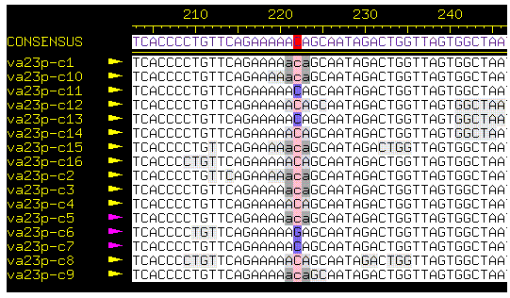
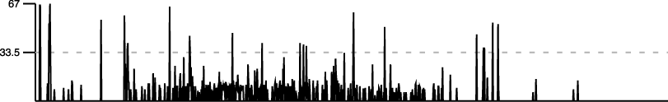
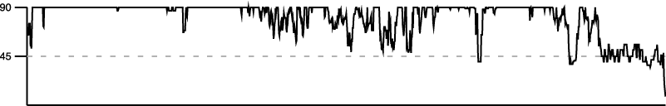
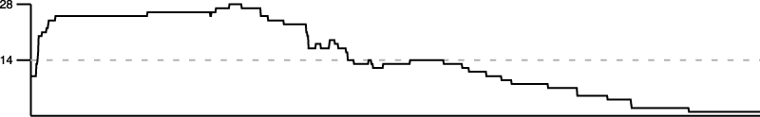
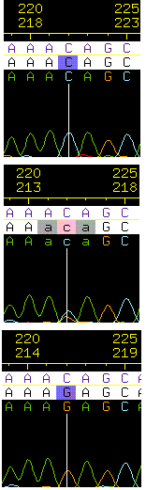
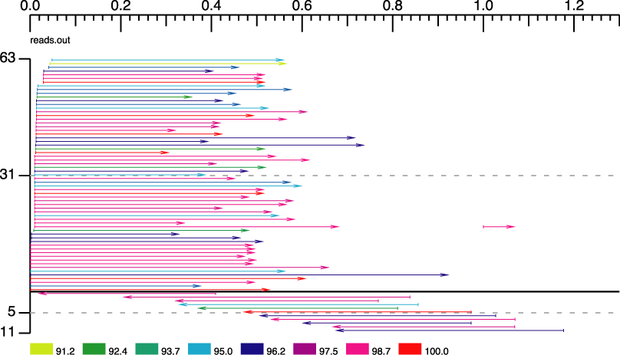
… with complex relationships …
SNP Score
Contig Summaries
Discrepancies
Contig Qualities
Coverage Depth
Trace
Reads
Aligned bases
Read quality
Contig
Percent match
6

Slide 7
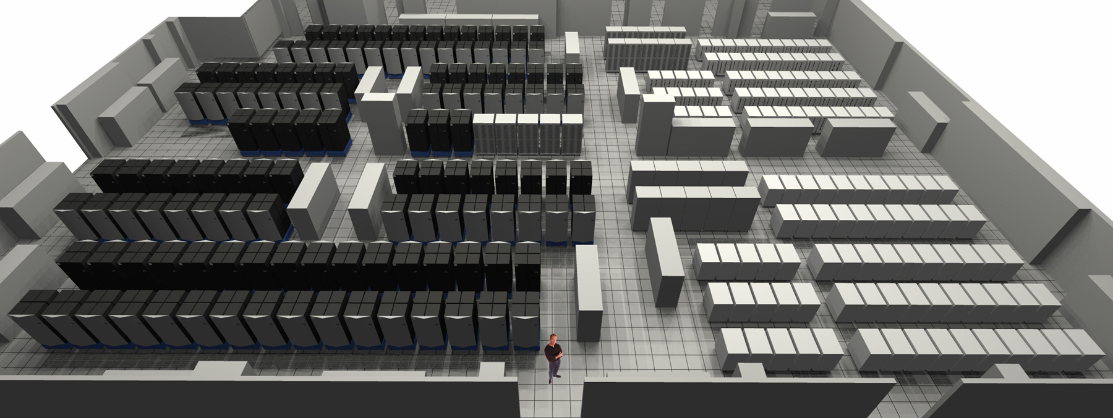


… on big computers …
… and small computers …
7

Slide 8


Slide 9
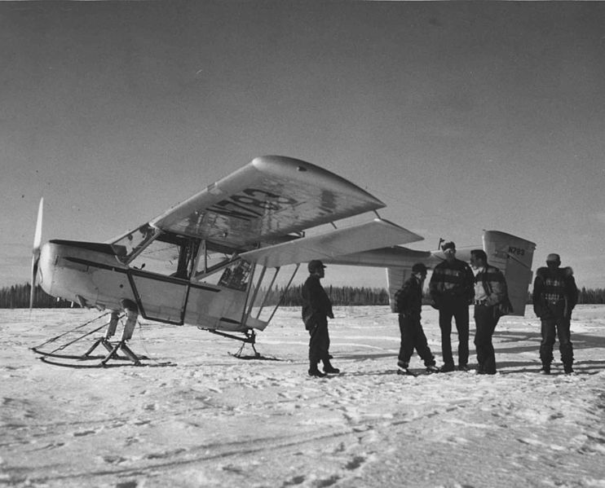

Slide 10
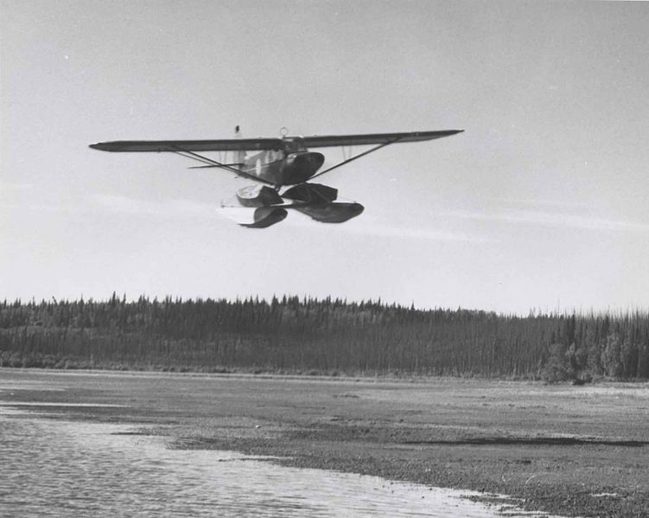

Slide 11


Slide 12
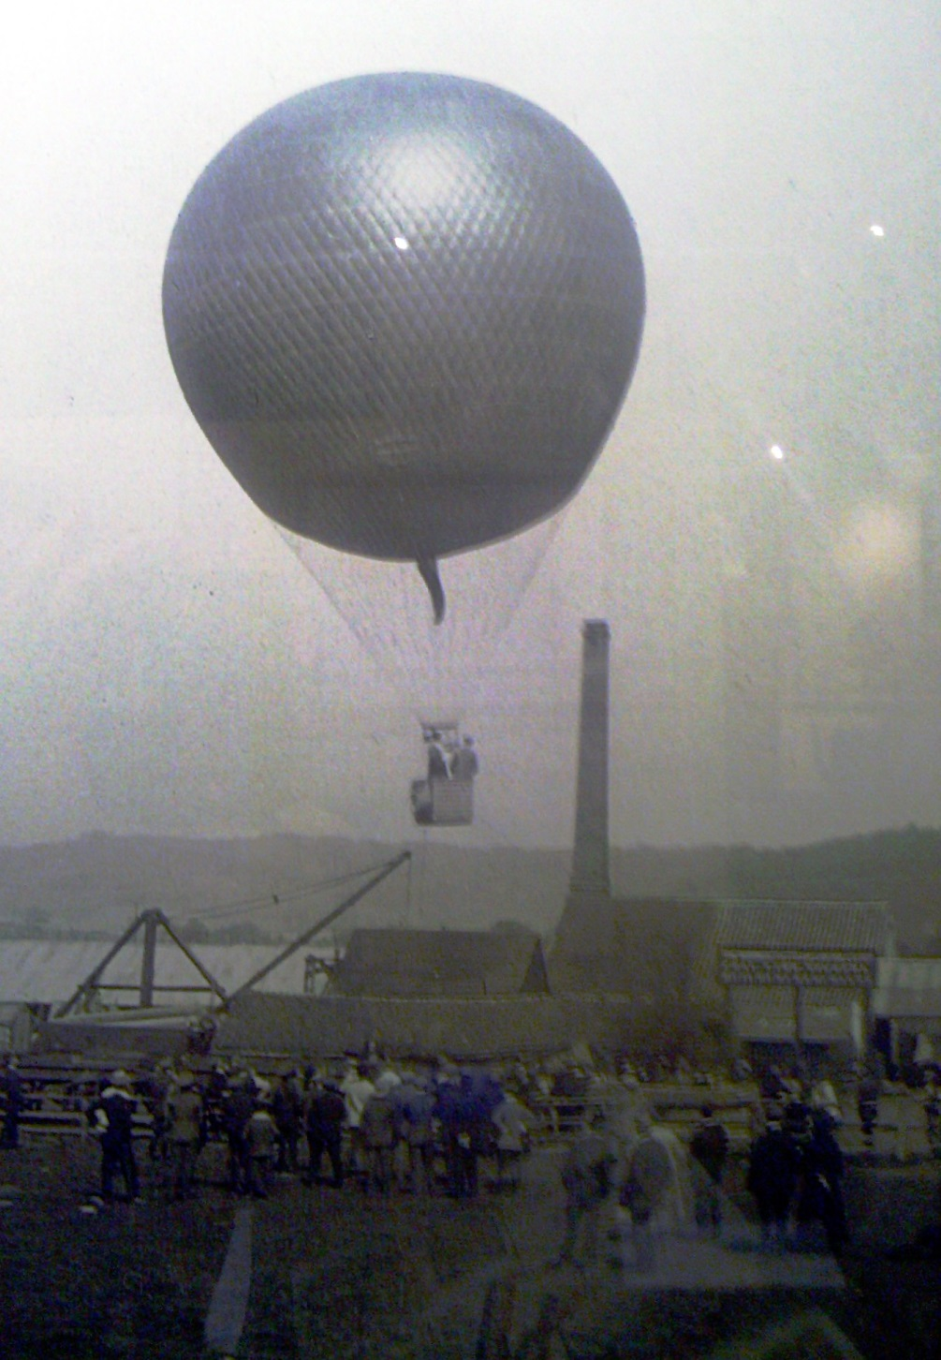

Slide 13


Slide 14


Slide 15
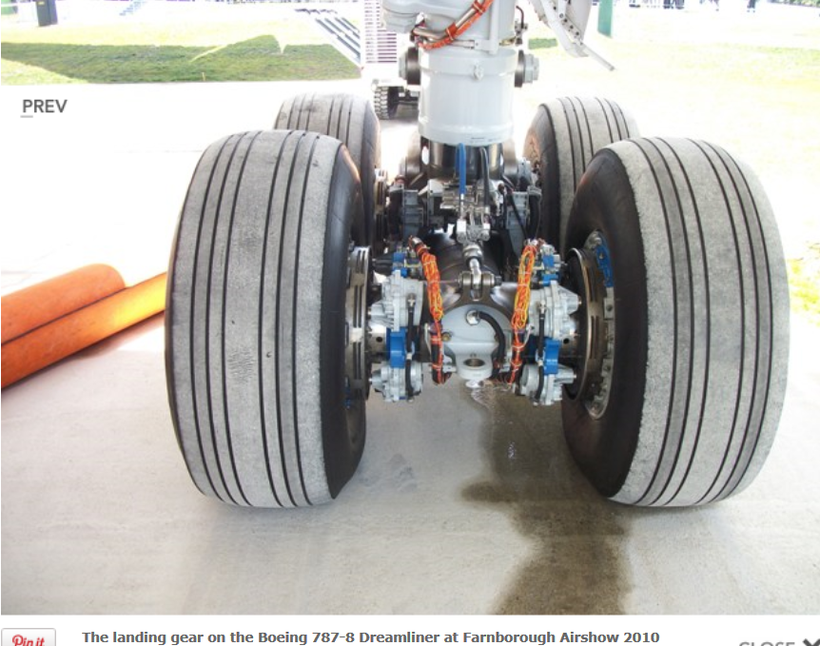

Slide 16
HDF5 Philosophy
A single platform with multiple uses
One general data model
One general format
One library
Adaptable for almost any kind of data
Works on almost any architecture
Ability to interact well with other technologies
Attention to past, present, future compatibility

Slide 17
Introduction to HDF5
Mike McGreevy
The HDF Group
The 14th HDF and HDF-EOS Workshop
September 28-30, 2010

Slide 18
What is HDF5?
Open file format
Designed for high volume or complex data
Open source software
Works with data in the format
A data model
Structures for data organization and specification

Slide 19
HDF = Hierarchical Data Format
HDF4 is the first HDF
Originally called HDF; last major release was version 4
HDF5 benefits from lessons learned with HDF4
Changes to file format, software, and data model
HDF5 and HDF4 are different
No plans for an HDF6!

Slide 20
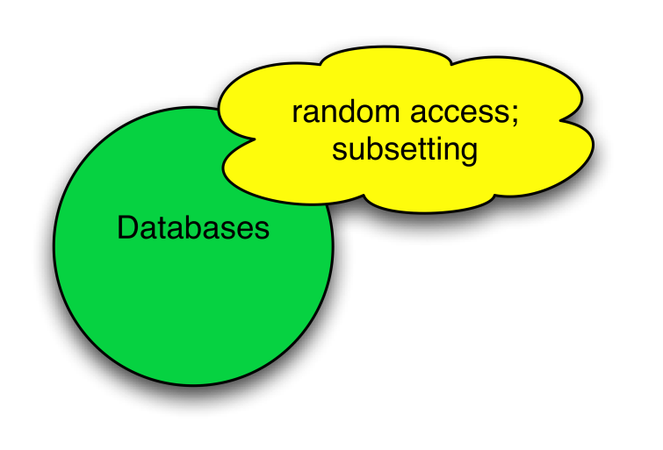
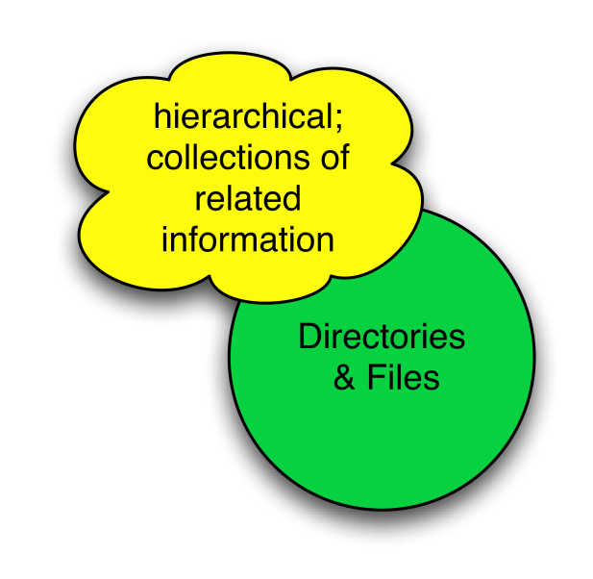
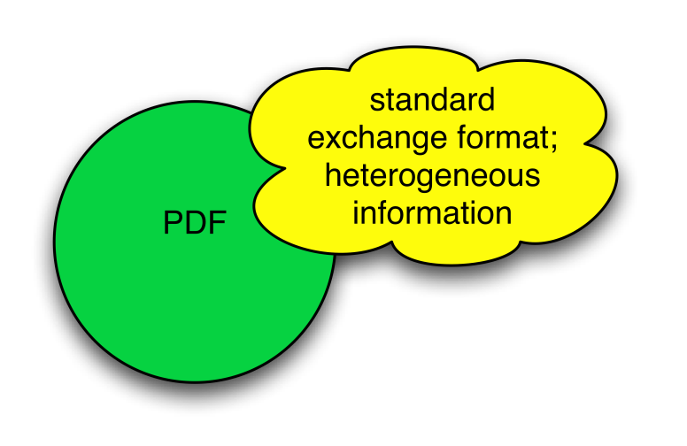
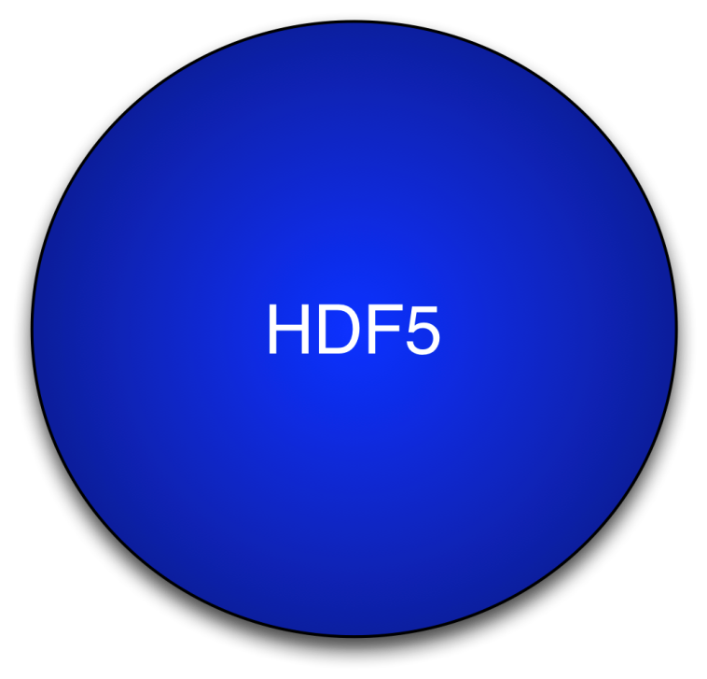
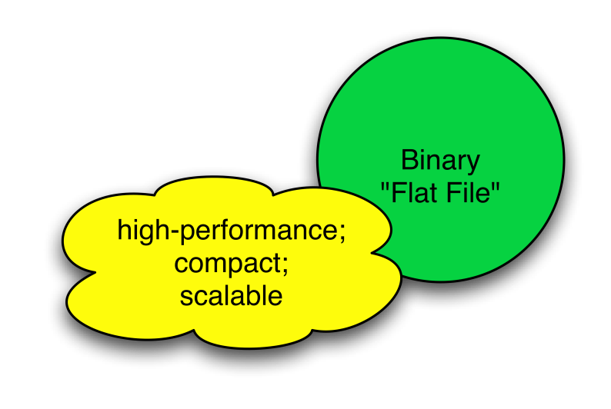
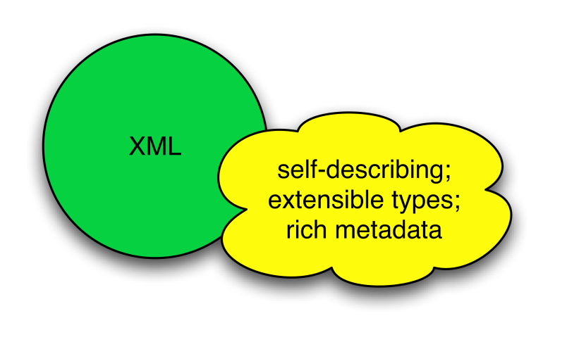
HDF5 is like …

Slide 21
HDF5 is designed …
for high volume and/or complex data
for every size and type of system (portable)
for flexible, efficient storage and I/O
to enable applications to evolve in their use of HDF5 and to accommodate new models
to support long-term data preservation

Slide 22
HDF5 Technology Platform
HDF5 data model
The “building blocks” for data organization and specification
HDF5 software
Library, language interfaces, tools
HDF5 file format
Bit-level organization of HDF5 file
Recall…
Let’s look at ….

Slide 23
HDF5 Data Model
Dataset
Link
Group
HDF5 Objects
Datatype
Attribute
Dataspace
File
a.k.a. HDF5 Abstract Data Model a.k.a. HDF5 Logical Data Model

Slide 24
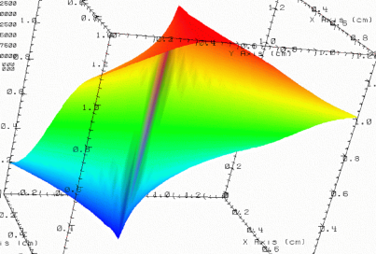


HDF5 File
lat | lon | temp
----|-----|-----
12 | 23 | 3.1
15 | 24 | 4.2
17 | 21 | 3.6
An HDF5 file is a container that holds data objects.
Experiment Notes:
Serial Number: 99378920
Date: 3/13/09
Configuration: Standard 3

Slide 25
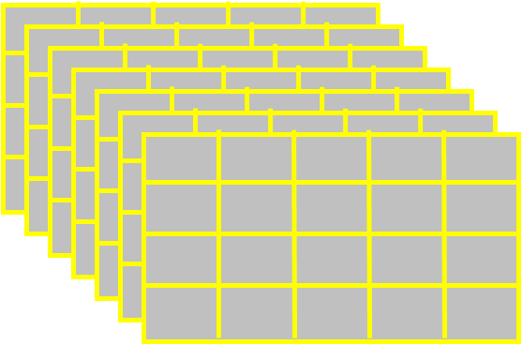
HDF5 Dataset
HDF5 Datatype
Integer 32bit LE
HDF5 Dataspace
Rank
Dimensions
3
Dim_0 = 4
Dim_1 = 5
Dim_2 = 7
Specifications for single data element and array dimensions
Multi-dimensional array of
identically typed data elements
HDF5 datasets organize and contain “raw data values”.
HDF5 datatypes describe individual data elements.
HDF5 dataspaces describe the logical layout of the data elements.

Slide 26
HDF5 Datatypes
Describe individual data elements in an HDF5 dataset
Wide range of datatypes supported
Integer
Float
Unsigned
User-defined (e.g., 13-bit integer)
Variable length types (e.g., strings)
Compound (similar to C structs)
Many more …
HDF/HDF-EOS Workshop XIV

Slide 27
HDF5 Dataset
3
5
12
Datatype: 32-bit Integer
Dataspace: Rank = 2 Dimensions = 5 x 3

Slide 28
HDF5 Dataset with Compound Datatype
3
5
V
V
V
V V V
V V V
int16
char
int32
2x3x2 array of float32
Compound
Datatype:
Dataspace: Rank = 2 Dimensions = 5 x 3

Slide 29
HDF5 Data Model: Are we there yet?
HDF5 Objects
Group
and Link
Attribute
Dataspace
✓
Datatype
✓
Dataset
✓
File
✓
HDF/HDF-EOS Workshop XIV

Slide 30
HDF5 Attributes
Typically contain user metadata
Have a name and a value
Are associated with HDF5 objects.
Analogous to a dataset
HDF/HDF-EOS Workshop XIV

Slide 31



HDF5 Groups and Links
HDF5 groups and links organize data objects.
Every HDF5 file
has a root group
/
Experiment Notes:
Serial Number: 99378920
Date: 3/13/09
Configuration: Standard 3
Parameters
10;100;1000
Viz
SimOut
lat | lon | temp
----|-----|-----
12 | 23 | 3.1
15 | 24 | 4.2
17 | 21 | 3.6
Timestep
36,000

Slide 32
HDF5 Technology Platform
HDF5 data model
The “building blocks” for data organization and specification
Let’s look at ….
HDF5 software
Library, language interfaces, tools

Slide 33
HDF5 Layers
HDF5 Application
Application buffer
HDF5 Object Layer (API)
H5Dwrite is called
HDF5 Internals
Data is prepared for I/O
VFD Layer
SEC2 driver performs
I/O
HDF5 file
Notes:
PHDF5 is built on top of MPI I/O APIs

Slide 34
HDF5 API and Applications
Applications
EOS
Application
MATLAB
Domain Data Objects
EOS
library
…
HDF5 Library
Storage

Slide 35
HDF5 Software Layers & Storage
Tools
…
High Level
APIs
API
h5dump
tool
h5repack
tool
HDFview
tool
Java Interface
HDF5 Library
Language
Interfaces
HDF5 Data Model Objects Groups, Datasets, Attributes, …
Tunable Properties Chunk Size, I/O Driver, …
C, Fortran, C++
Internals
Memory Mgmt
Datatype Conversion
Filters
Chunked Storage
Version Compatibility
and so on…
Virtual File Layer
Posix I/O
Split Files
Custom
MPI I/O
I/O Drivers
Storage
HDF5 File Format
File on Parallel Filesystem
?
File
Split Files
Other

Slide 36
Useful Tools For New Users
h5dump:
Tool to “dump” or display contents of HDF5 files
h5cc, h5c++, h5fc:
Scripts to compile applications
HDFView:
Java browser to view HDF4 and HDF5 files
http://www.hdfgroup.org/hdf-java-html/hdfview/

Slide 37
What makes HDF5 special? What is its “secret sauce?”
(It’s an open secret.)

Slide 38
Secret Sauce: File structures and metadata

Slide 39

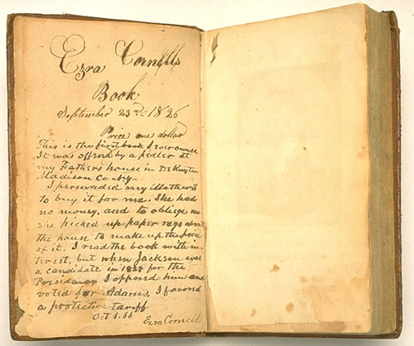
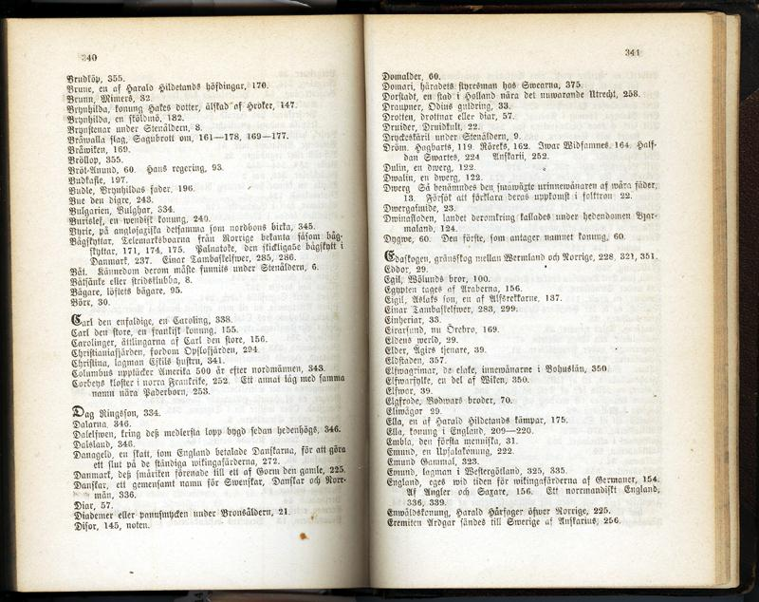
File structures and metadata
sequential
random access
with metadata

Slide 40
Secret sauce: Groups and Links

Slide 41
/
links.h5
A
B
dangling
a
a
External
This dataset is in a different file
Notes:
Example h5_links.py creates a file links.h5 and two groups “A” and “B” in it.
Then it creates a one-dimensional array “a” in group “A”. After the datasets was created a hard link “a” was added to the root group. (It is one dimensional in example and doesn’t have data). Also soft link with the value “/A/a” was added to the root group along with the dangling soft link “dangling”.
External link “External” was added to group B. It points to a dataset “dset” in dset.h5.

Slide 42
Secret Sauce: HDF5 metadata

Slide 43
HDF5 metadata
Information about an HDF5 file and its contents
Stored in the file
Used by software to understand what’s in the file and how it’s organized
It’s how HDF5 can be “self-describing”
Like table of contents, index, front matter in a book
Usually small compared to raw data (KB vs. MB-GB)
But it takes time to read them and write them

Slide 44
HDF5 metadata
File and object descriptions
Indexes for groups and chunks
Attributes on objects

Slide 45
HDF5 dataset components
Dataset header
Dataset data array
Dataspace
Rank
Dimensions
3
Dim_1 = 4
Dim_2 = 5
Dim_3 = 7
Datatype
IEEE 32-bit float
Attributes
Storage info
Time = 32.4
Chunked
Pressure = 987
Compressed
Temp = 56
Metadata
Raw data

Slide 46
Secret sauce: HDF5 datatypes

Slide 47
HDF5 Datatypes
Describe individual data elements in an HDF5 dataset
Wide range of datatypes supported
Integer
Float
Unsigned
User-defined (e.g., 13-bit integer)
Variable length types (e.g., strings)
Compound (similar to C structs)
Many more …
HDF/HDF-EOS Workshop XIV

Slide 48
Secret sauce: HDF5 software layers

Slide 49
HDF5 Layers
HDF5 Application
Application buffer
HDF5 Object Layer (API)
H5Dwrite is called
HDF5 Internals
Data is prepared for I/O
VFD Layer
SEC2 driver performs
I/O
HDF5 file
Notes:
PHDF5 is built on top of MPI I/O APIs

Slide 50
HDF5 API and Applications
Applications
EOS
Application
MATLAB
Domain Data Objects
EOS
library
…
HDF5 Library
Storage

Slide 51
HDF5 Software Layers & Storage
Tools
…
High Level
APIs
API
h5dump
tool
h5repack
tool
HDFview
tool
Java Interface
HDF5 Library
Language
Interfaces
HDF5 Data Model Objects Groups, Datasets, Attributes, …
Tunable Properties Chunk Size, I/O Driver, …
C, Fortran, C++
Internals
Memory Mgmt
Datatype Conversion
Filters
Chunked Storage
Version Compatibility
and so on…
Virtual File Layer
Posix I/O
Split Files
Custom
MPI I/O
I/O Drivers
Storage
HDF5 File Format
File on Parallel Filesystem
?
File
Split Files
Other

Slide 52
Secret Sauce: Partial i/o

Slide 53
Subsetting – Sample mappings between File Dataspaces and Memory Dataspaces
(a) Hyperslab from a 2D array to the corner of a smaller 2D array
(b) Regular series of blocks from a 2D array to a contiguous sequence at a certain offset in a 1D array
(c) A sequence of points from a 2D array to a sequence of points in a 3D array.
(d) Union of hyperslabs in file to union of hyperslabs in memory.

Slide 54
Secret Sauce: HDF5 storage layouts

Slide 55
HDF5 datasets storage layouts
Contiguous
Chunked
External
Compact

Slide 56
Contiguous storage layout

Slide 57
Dataset storage
A dataset (conceptual view)
4 rows, 3 columns
But how is it organized in memory or on a disk?
1 2 3 4 5 6 7 8
9 10 11 12 13 14 15 16
17 18 19 20 21 22 23 24
25 26 27 28 29 30 31 32

Slide 58
Dataset storage
A dataset (conceptual view)
1 2 3 4 5 6 7 8
9 10 11 12 13 14 15 16
17 18 19 20 21 22 23 24
25 26 27 28 29 30 31 32
Linearized (how dataset is stored on disk)
1 2 3 4 5 6 7 8 9 10 … 28 29 30 31 32
Here the data is “contiguous” – all together in one place.

Slide 59
Writing contiguous dataset

Slide 60
Writing contiguous dataset
Application memory
Metadata cache (MDC)
Dataset array data
Dataset header
Dataset array data
Dataset header
HDF5 File
Raw data is written first.
The header is written when flushed to file

Slide 61
Secret sauce: Chunking

Slide 62
Chunked storage layout
Chunking – a dataset is partitioned in fixed-size multi-dimensional tiles or chunks
Each chunk is stored as contiguous block
HDF5 library treats each chunk as atomic object for I/O
Greatly affects performance and file sizes
Use for
datasets with filters (checksum, compression)
sub-setting of big datasets
extendible datasets

Slide 63
Dataset storage
A dataset (conceptual view)
1 2 3 4 5 6 7 8
9 10 11 12 13 14 15 16
17 18 19 20 21 22 23 24
25 26 27 28 29 30 31 32
Chunked (conceptual view)
1 2 3 4
9 10 11 12
5 6 7 8
13 14 15 16
17 18 19 20
25 26 27 28
21 22 23 24
29 30 31 32

Slide 64
Dataset storage
Chunked (conceptual view)
1 2 3 4
9 10 11 12
5 6 7 8
13 14 15 16
17 18 19 20
25 26 27 28
21 22 23 24
29 30 31 32
Linearized (how chunks are stored on disk)
1 2 3 4 9 10 11 12
5 6 7 8 13 14 15 16
17 18 19 20 25 26 27 28
21 22 23 24 29 30 31 32
Chunks are not contiguous on disk. They are stored separate from one another.

Slide 65
Chunked storage layout
Chunking – a dataset is partitioned in fixed-size multi-dimensional tiles or chunks
Each chunk is stored as contiguous block
HDF5 library treats each chunk as atomic object for I/O
Greatly affects performance and file sizes
Use for
datasets with filters (checksum, compression)
sub-setting of big datasets
extendible datasets

Slide 66
What is HDF5 chunking?
Data is stored in chunks of predefined size
Two-dimensional instance sometimes referred to as data tiling
Chunked
Contiguous

Slide 67
Why HDF5 chunking?
If used appropriately chunking improves partial I/O for big datasets
Only two chunks are involved in I/O

Slide 68
Why HDF5 chunking?
When dataset is compressed, you only have to uncompress the chunks you need
Only two chunks need to be uncompressed

Slide 69
Why HDF5 chunking?
When dataset is compressed, you only have to uncompress the chunks you need
Only two chunks need to be uncompressed

Slide 70
Why HDF5 chunking?
When dataset is compressed, you only have to uncompress the chunks you need
Only two chunks need to be uncompressed

Slide 71
But wait, there’s more…
Chunk size and shape
Chunk cache
Direct chunk writing
Parallel chunk I/O

Slide 72
Chunked storage layout
Chunking – a dataset is partitioned in fixed-size multi-dimensional tiles or chunks
Each chunk is stored as contiguous block
HDF5 library treats each chunk as atomic object for I/O
Greatly affects performance and file sizes
Use for
datasets with filters (checksum, compression)
sub-setting of big datasets
extendible datasets

Slide 73
Secret sauce: External storage

Slide 74
External storage layout
Dataset raw data is stored in an external file(s) that should be kept together with the HDF5 file
Layout in the external file is specified by an application
An easy way to make legacy data available to HDF5 library

Slide 75
External storage layout
Metadata cache (MDC)
Application memory
Dataset array data
Dataset header
HDF5 file
Unix/Windows file
Dataset header
Metadata is stored in HDF5 file.
Raw data is stored in a separate file as specified by application

Slide 76
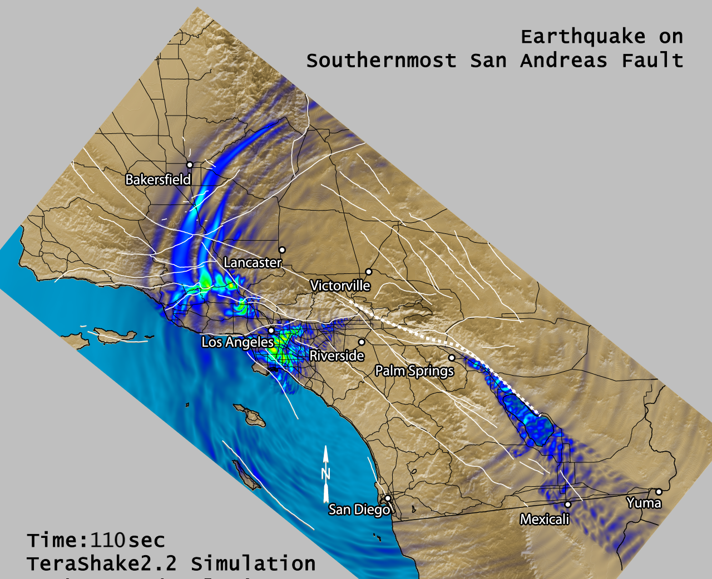
SCEC TeraShake

Slide 77
SCEC TeraShake
The Southern California Earthquake Center digital library publishes scientific data generated by seismic wave propagation simulations.
The output from a single simulation may be as large as 50 Terabytes of data and 400,000 files. The total size of the digital library is over 130 Terabytes with nearly three million files.

Slide 78
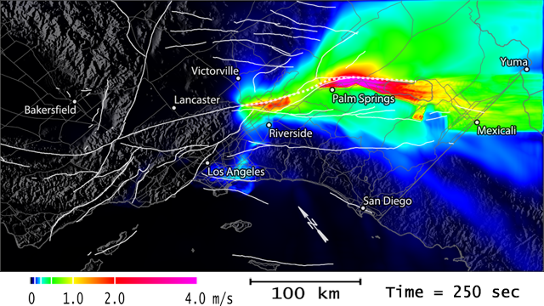
TeraShake Surface Seismograms
4D Array (1.2 TB)
Time (22,728)
Horizontal (3,000)
Vertical (1,500)
Vector Component (3)
Each file:
22,728 x 3,000 x 5 x 1
1,363,680,000 Bytes
TeraShake scenario
900 files

Slide 79
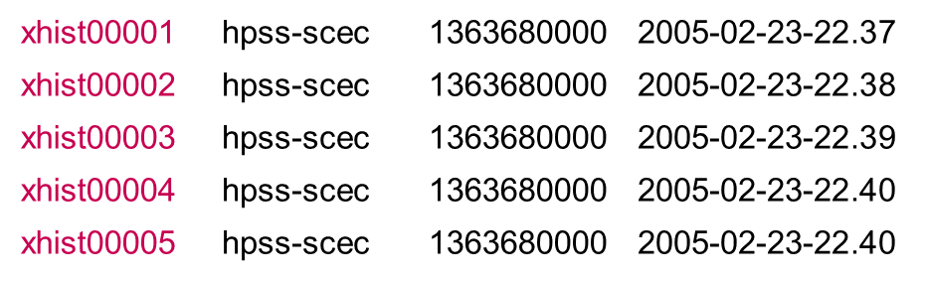
Example HDF5 File
HDF5
File
32-bit
float
22,728
3,000
25

Slide 80
Secret sauce: Compact storage layout

Slide 81
Compact storage layout
Raw data and metadata stored together
Raw data read/written with metadata
Use for small (few K) datasets to minimize small I/O operations

Slide 82
Writing compact dataset
Application memory
Metadata cache (MDC)
Dataset array data
Dataset header
Dataset header
HDF5 File
Raw data is written when object header is written

Slide 83
Secret Sauce: Virtual file drivers

Slide 84
HDF5 Layers
HDF5 Application
Application buffer
HDF5 Object Layer (API)
H5Dwrite is called
HDF5 Internals
Data is prepared for I/O
VFD Layer
File driver performs
I/O
HDF5 file
Notes:
PHDF5 is built on top of MPI I/O APIs

Slide 85
HDF5 Software Layers & Storage
Tools
…
High Level
APIs
API
h5dump
tool
h5repack
tool
HDFview
tool
Java Interface
HDF5 Library
Language
Interfaces
HDF5 Data Model Objects Groups, Datasets, Attributes, …
Tunable Properties Chunk Size, I/O Driver, …
C, Fortran, C++
Internals
Memory Mgmt
Datatype Conversion
Filters
Chunked Storage
Version Compatibility
and so on…
Virtual File Layer
Posix I/O
Split Files
Custom
MPI I/O
I/O Drivers
Storage
HDF5 File Format
File on Parallel Filesystem
?
File
Split Files
Other

Slide 86
HDF5 VFDs
sec2¹ (default)
Windows²
STDIO³
core (in-memory)
log
split
multi
family
MPI
MPI-POSIX
"logical" VFDs which perform no I/O themselves
1) Uses POSIX I/O (sec2 = "POSIX section 2")
2) Currently a wrapper for SEC2. There is no driver which uses Win32 API calls.
3) "How to write a VFD" demo driver. Not intended for production use.
Notes:
Talk about sec2, Windows here.
The purple VFDs are "logical" VFDs that partition data and require one of the other VFDs for actual I/O operations.
Point out the stdio is a demo driver and NOT for production use. We'll talk about writing your own VFD later.
MPI will not be covered
Other VFDs will be covered later, on their own slides

Slide 87
Secret sauce: HDF5 filters

Slide 88
What is an HDF5 filter?
Data transformation performed by the HDF5 library during I/O operations
Built-in filters
Come with the HDF5 library
User-defined filters
Written by HDF5 users and/or available with some applications (h5py, PyTables)
May be or may not be registered with The HDF Group

Slide 89
Types of HDF5 Filters
Built-in
Algebraic data transformation
Data shuffling
Checksum
Data compression
Scale + offset, N-bit, GZIP, SZIP
Community-supported compression filters
LZO, BZIP2, BLOSC, LZF, MAFISC

Slide 90
HDF5 filters
Filters are arranged in a pipeline so the output of one filter becomes the input of the next filter

Slide 91
Secret sauce: Parallel HDF5

Slide 92


Slide 93
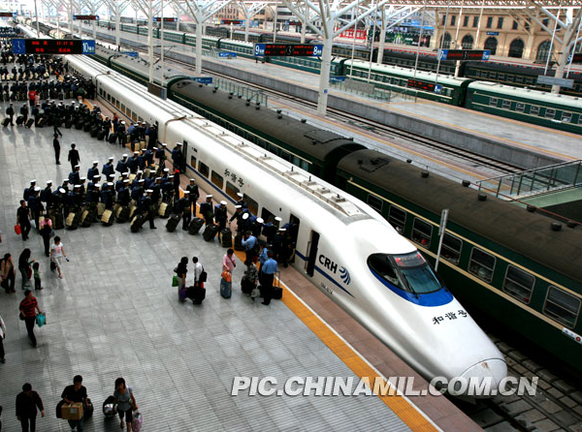

Slide 94
Overview of parallel HDf5 design

Slide 95
PHDF5 requirements
PHDF5 should allow multiple processes to perform I/O to an HDF5 file at the same time
Single file image to all processes
Compare with one file per process design:
Expensive post processing
Not usable by different number of processes
Too many files produced for file system
Notes:
Support Message Passing Interface (MPI) programming
PHDF5 files compatible with serial HDF5 files
Shareable between different serial or parallel platforms
Single file image to all processes
One file per process design is undesirable
Expensive post processing
Not usable by different number of processes

Slide 96
PHDF5 requirements
Should use a standard parallel I/O interface
Must be portable to different platforms
Support Message Passing Interface (MPI) programming
PHDF5 files compatible with serial HDF5 files
Shareable between different serial or parallel platforms

Slide 97
HDF5 Layers
HDF5 Application
Application buffer
HDF5 Object Layer (API)
H5Dwrite is called
HDF5 Internals
Data is prepared for I/O
VFD Layer
SEC2 driver performs
I/O
HDF5 file
Notes:
PHDF5 is built on top of MPI I/O APIs

Slide 98
PHDF5 implementation layers
HDF5 Application
Compute node
Compute node
Compute node
HDF5 I/O Library
MPI I/O Library
HDF5 file on Parallel File System
Switch network/I/O servers
Disk architecture and layout of data on disk
Notes:
PHDF5 is built on top of MPI I/O APIs

Slide 99
Trillion particle simulation

Slide 100
Advantage of parallel HDF5
Trillion Particle VPIC Simulation
Problem: Support I/O and analysis needs for state-of-the-art plasma physics code

Slide 101
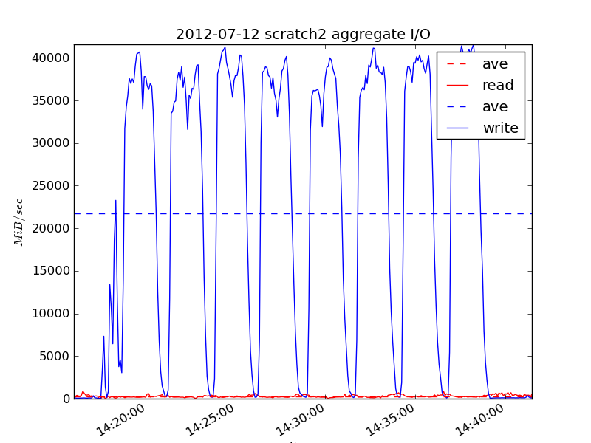
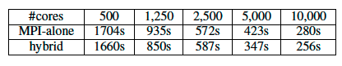
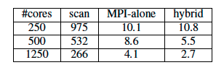
Trillion particle simulation
Ran Trillion particle simulation on 120,000 hopper cores
Generated 350 TB dataset
Parallel HDF5 obtained peak 35GB/s I/O rate and 80% sustained bandwidth
FastQuery took 10 minutes to index and 3 seconds to query energetic particles
CS Impact
Demonstrated software scalability for writing and analyzing ~40TB HDF5 files
Enabled novel discoveries in plasma physics (next slide)
I/O bandwidth utilization for parallel writes (blue) with HDF5 on 120,000 cores
A comparison of indexing (top table) and query times (bottom) for hybrid and MPI-FastQuery
Notes:
The slide highlights recent accomplishments from the ExaHDF5 project funded by DOE/ASCR Exascale Scientific Data Management award.
1) Parallel I/O with HDF5
We ran a Trillion particle simulation on 120K cores on hopper. The code produced 30 TB of particle data per timestep, and produced over 350TB of data total
- To the best of our knowledge, this is the first time that anyone has demonstrated writes to a single, shared 30 TB HDF5 file
We hit peak I/O rates on hopper (~35GB/s) during the run, we sustained an average ~23GB/s, which is a new record for parallel HDF5 performance
2) FastBit based analysis-
We developed a novel hybrid parallel version of FastBit to do the indexing/querying on the dataset
This was the first time that we used FastBit and FastQuery to index and query a dataset with Trillion entries
We were able to index the dataset in 10 minutes and query the dataset in 3 seconds
DOE researchers: Prabhat (PI), Suren Byna, Oliver Rubel and John Wu (LBNL)
Scientific collaborators: Homa Karimabadi (UCSD), Vadim Roytershteyn (UCSD) and Bill Daughton (LANL)
Simulation code used in the study is VPIC, developed at LANL.
Please address any questions to Prabhat (prabhat@lbl.gov).

Slide 102
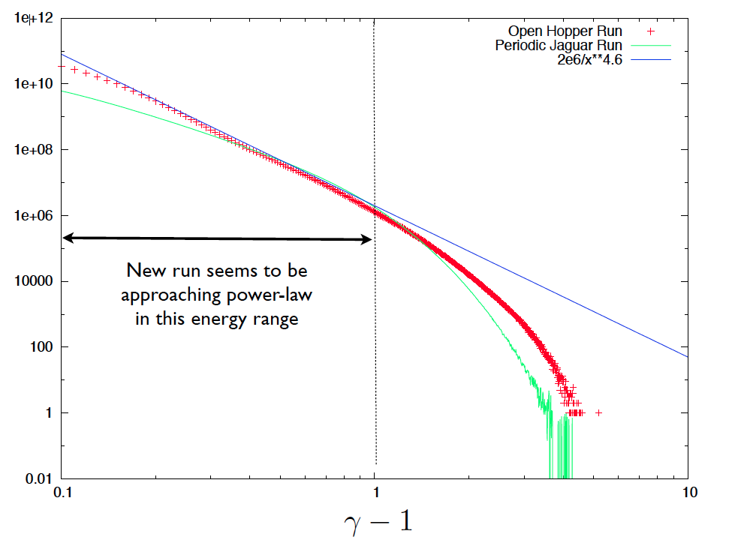
Multiple Scientific Discoveries in Plasma Physics
Preferential acceleration along magnetic field
Energetic particles are correlated with flux ropes
Discovered power-law in energy spectrum
Discovered agyrotropy near the reconnection hot-spot
Notes:
3) Scientific insights
This is the first time that our science collaborators have been able to examine the trillion particle dataset. They had largely ignored the particle data, or looked at a coarse grained version earlier
- Our collaborators discovered a power-law distribution in the energy spectrum of the particles. This is the first kinetic plasma physics to demonstrate a power-law distribution; our analysis capabilities directly facilitated this discovery
Our collaborators had made a number of conjectures and hypothesis regarding the interplay between particles and the magnetic fields and multi-dimensional phase-space distribution of particles. Using these new tools, they were able to confirm these hypothesis quantitatively. More specifically the scientists found:
- a preferential acceleration of particles in a direction parallel to the magnetic field
- predominant distribution of energetic particles in the current sheet, suggesting that flux ropes can confine these particles
agyrotropic (asymmetric) distribution of particles near the magnetic reconnection event

Slide 103
Secret sauce: metadata “journaling”

Slide 104
Journaling
Metadata
File
Suppose we have some interrelated metadata that we would like to write into a file

Slide 105
Journaling
Metadata
Corrupted File
X
?
If the write is interrupted (process killed, etc.), then we will have an invalid/corrupt file.

Slide 106
Journaling
Metadata
Transaction
File
2
1
Journal
Journaling avoids the corrupt file problem by recording the set of writes (a transaction) in a journal.

Slide 107
Journaling
Metadata
Transaction
File
X
Journal
h5recover
When a transaction is interrupted, a recovery tool can repair the file.

Slide 108
Secret sauce: writing and reading simultaneously

Slide 109
Single Writer / Multiple Reader (SWMR)
Dana Robinson
The HDF Group
Efficient Use of HDF5 With High Data Rate X-Ray Detectors
Paul Scherrer Institut

Slide 110
Basic Idea
Many use cases call for
a single writer which writes data to an HDF5 file
and multiple readers, which will consume the HDF5 data as it is written
Ideally, we would like to support this scenario with no communication between the processes (IPC).

Slide 111
Data
Independent Reader Processes
Writer
Reader
Reader
Reader
HDF5 File

Slide 112
Example
New data elements
Writer
Reader
Which can then be read by a reader.
With no IPC necessary.
HDF5 File
Are added to a dataset in the file.

Slide 113
A touch of reality

Slide 114


Slide 115
Bigger isn’t always better – Factors affecting I/O performance

Slide 116
HDF5 data structures
Data structures used by HDF5 library
B-trees (groups, dataset chunks)
Hash tables
Local and global heaps (variable length data: link names, strings, etc.)
Other concepts
HDF5 metadata cache
HDF5 chunk cache
Free space management data structure
Etc.

Slide 117
Operations on data inside HDF5 library
Copying to/from internal buffers
Datatype conversion, e.g.,
Float to integer
Little-endian to big-endian
64-bit integer to 16-bit integer
Variable-length data conversion from memory to file
Scattering - gathering
Data is scattered/gathered from/to application buffers into internal buffers for datatype conversion and partial I/O

Slide 118
Operations on data inside HDF5 library
Data transformation (filters, compression)
Checksum on raw data and metadata
Algebraic transform
GZIP and SZIP compressions
HDF5 and user-defined data transformations

Slide 119
I/O performance
I/O performance depends on many factors
Storage layouts
Dataset storage properties
Chunking strategy
Metadata cache performance
Datatype conversion performance
Other filters, such as compression
Access patterns

